Slide 1
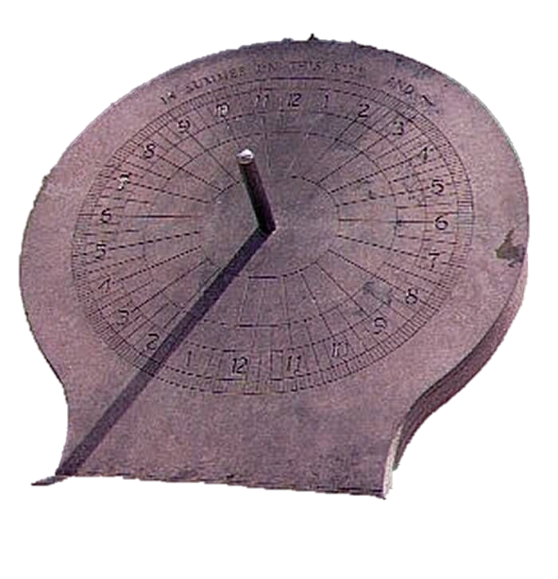
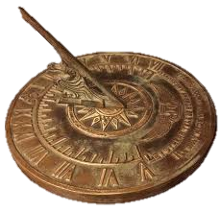
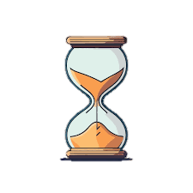
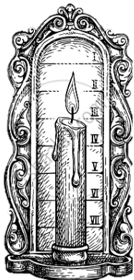
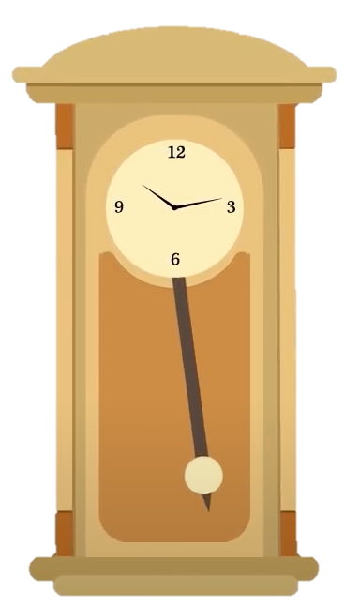
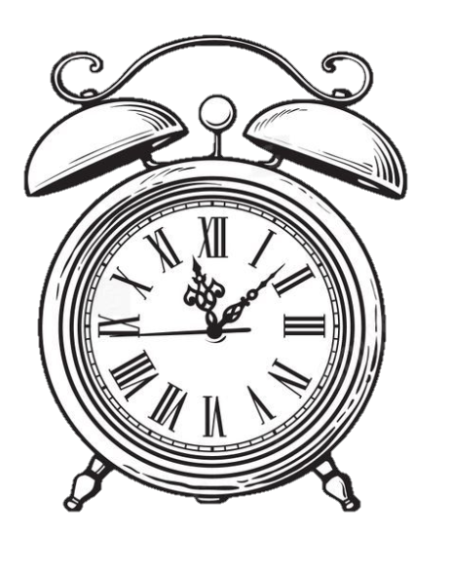
Time Measuring Techniques
Satyam R
22CH10062

Slide 2

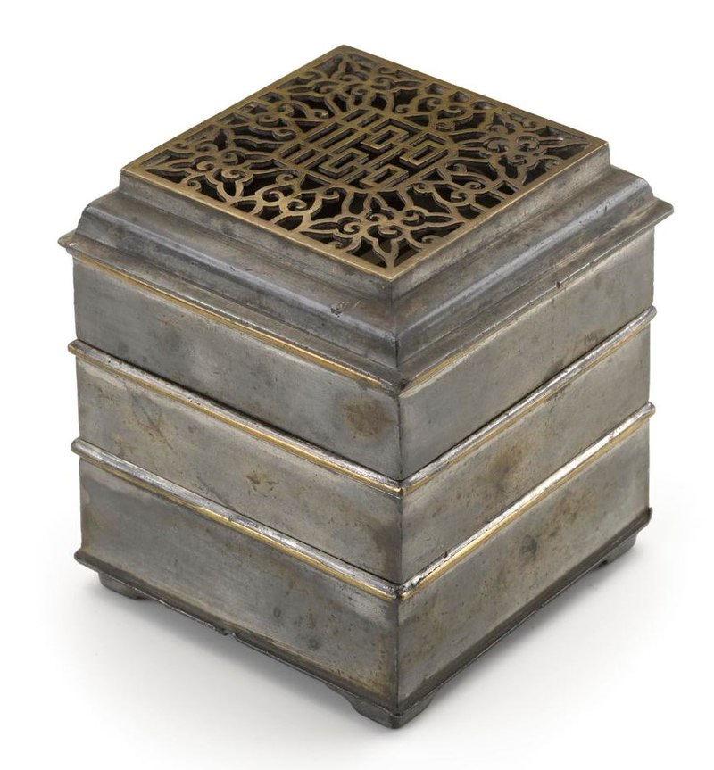
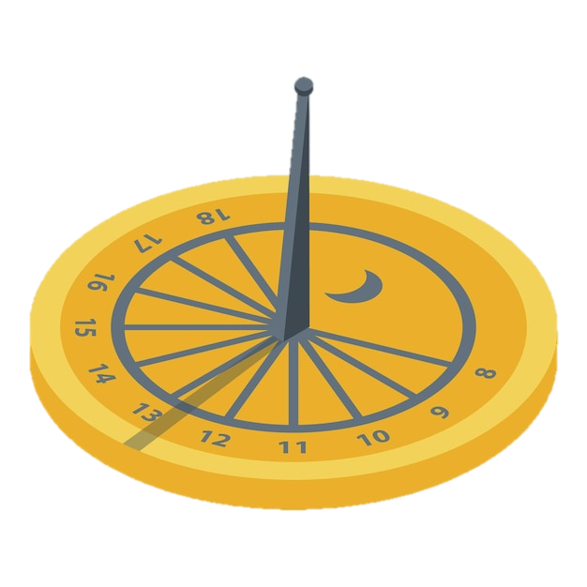
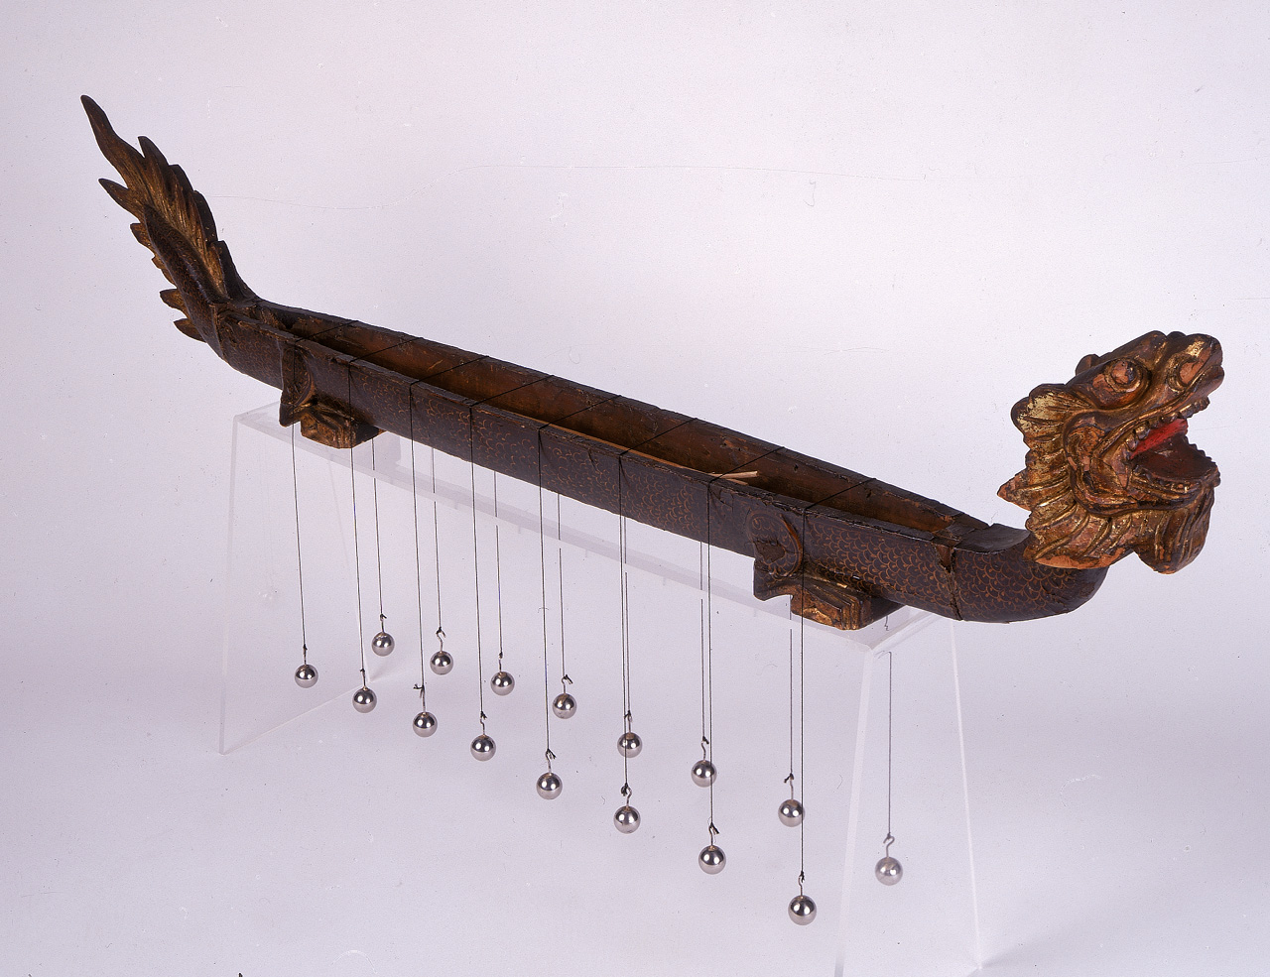
Evolution of timekeeping devices
Sundial
or
Shadow Clock
Ghatika Yantra
(Water Clock)
Incense clock

Slide 3
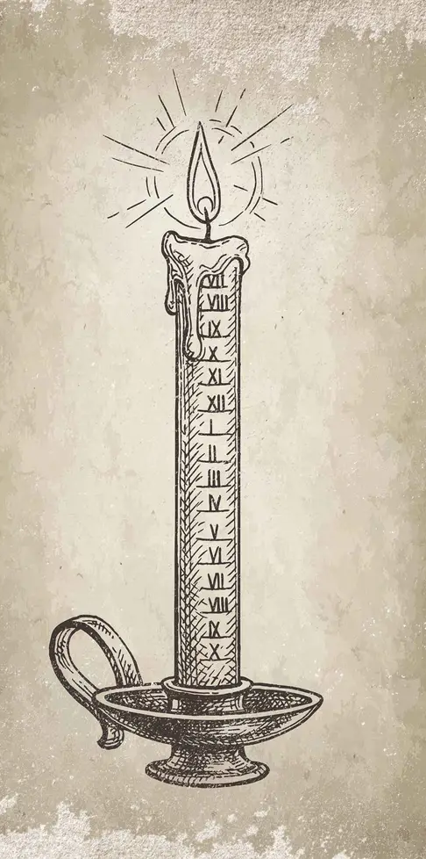
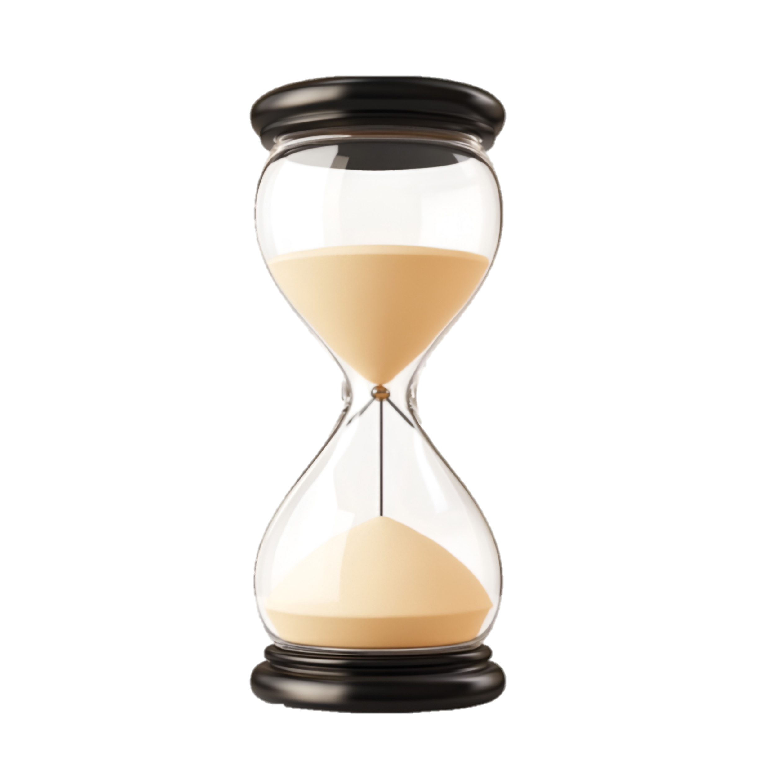
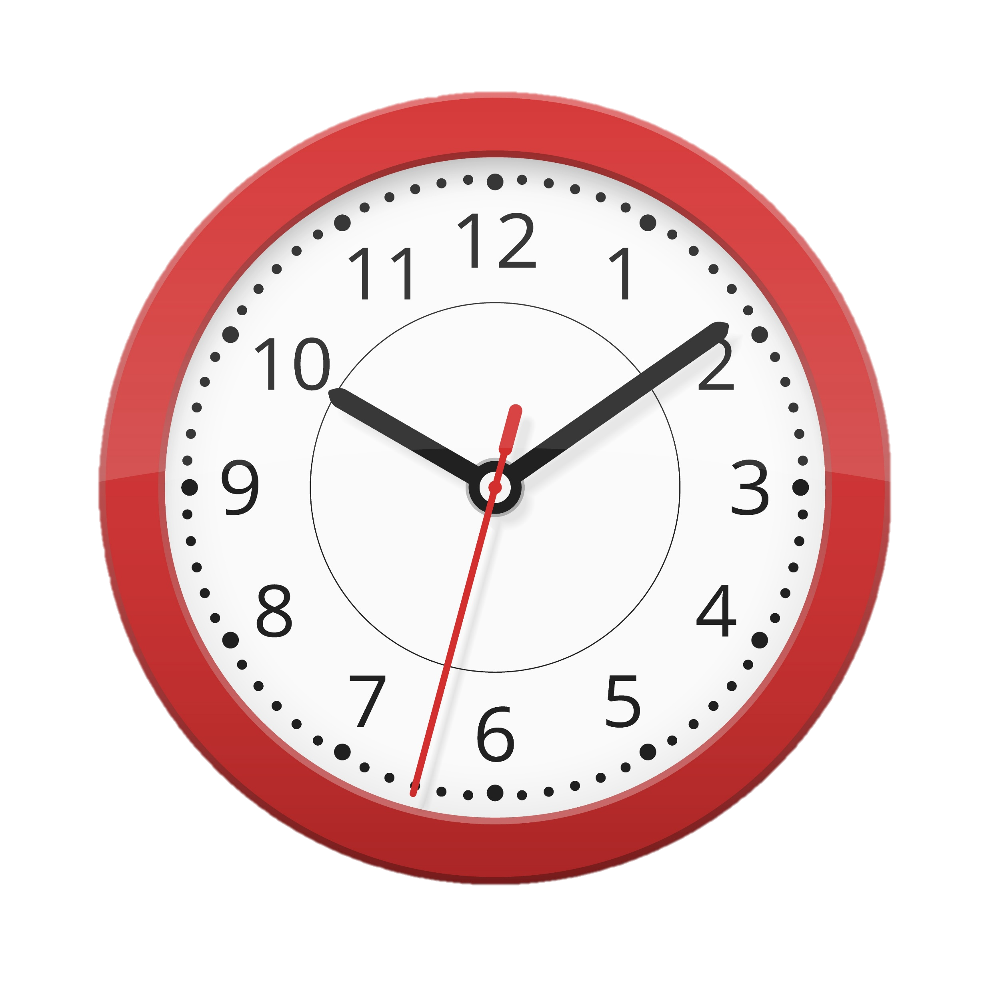

Evolution of timekeeping devices
Sand Hourglass
Candle Clock
(with Nail as alarm)
Mechanical clock

Slide 4
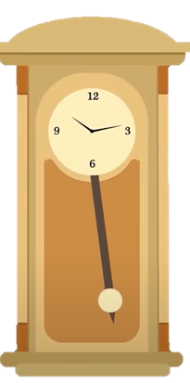
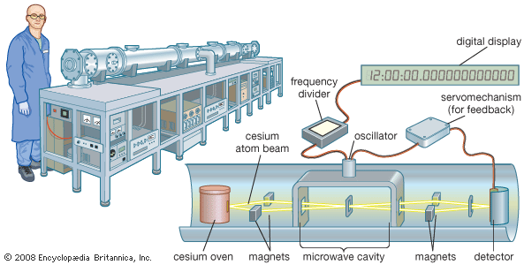
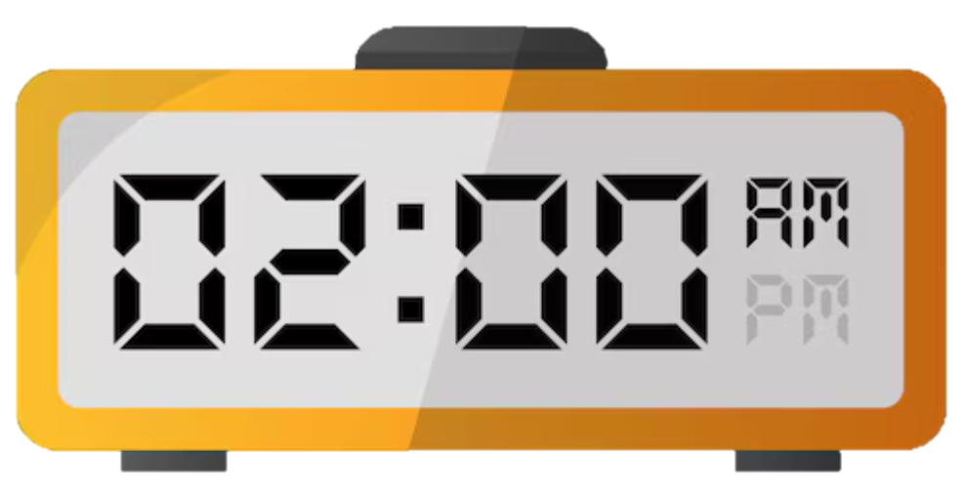
Evolution of timekeeping devices
Digital Clock
Atomic clock
Pendulum Clock

Slide 5
Water based time measuring Instruments
Egyptian Water clock
Greek Water clock
Indian water clock(Ghatika Yantra)

Slide 6
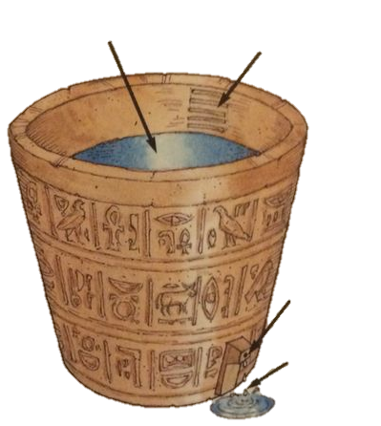
Water
Egyptian Water clock
Measuring Scale
They marked the inside of a pot at measured spaces and made a small hole near the bottom of the container.
Then they filled it with water. As the water dripped through the hole, the level inside the pot dropped below the marks.
This told them how much time had passed from beginning.
Hole
Dripping
water

Slide 7
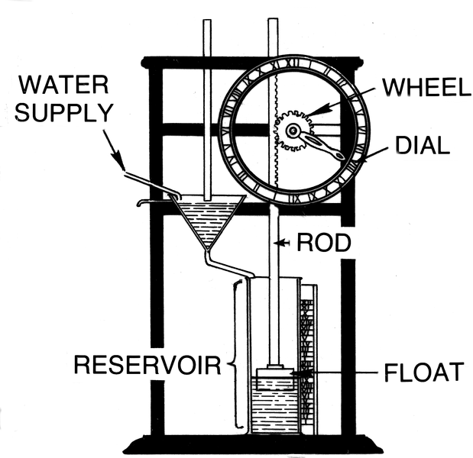
Greek Water clock
The Ancient Greeks used water clocks, called "clepsydras" or "water thieves," to measure time.
Water is supplied continuously at steady rate into the reservoir.
Due to inflow of water, level of water in the reservoir rises and hence the float due to buoyancy force.
The float is connected to the gear of the clock’s dial through a rod and hence as float moves up the dial of clock also moves in clockwise direction
Overflow

Slide 8
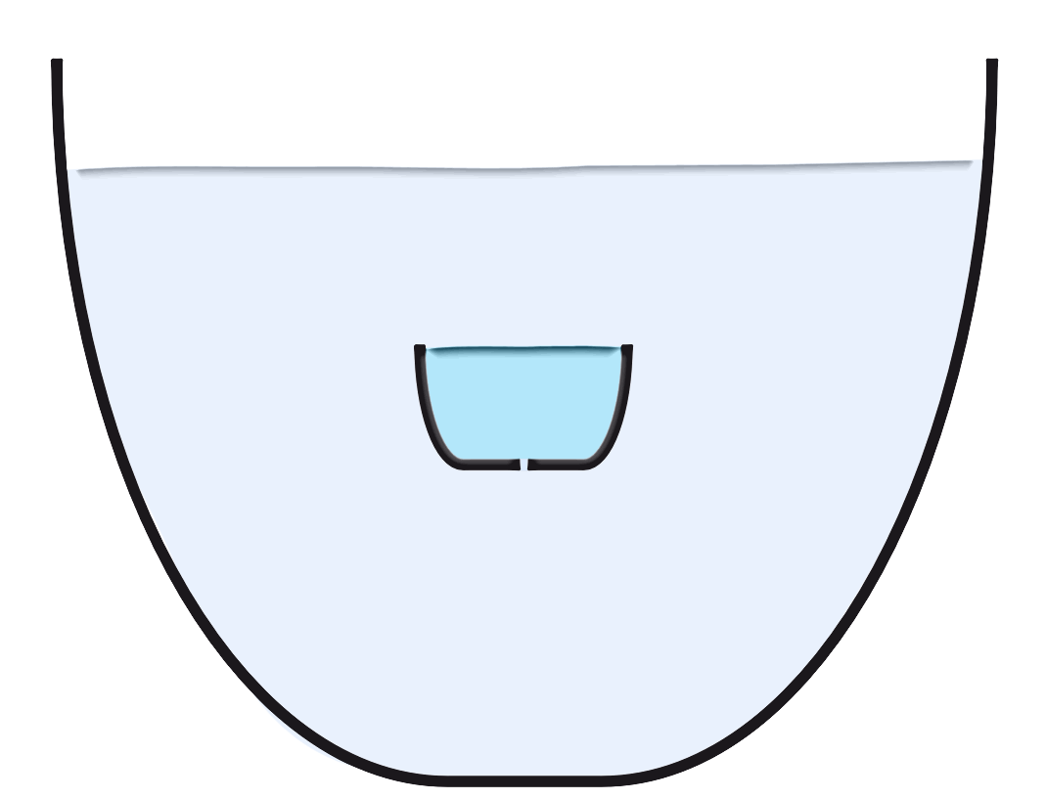
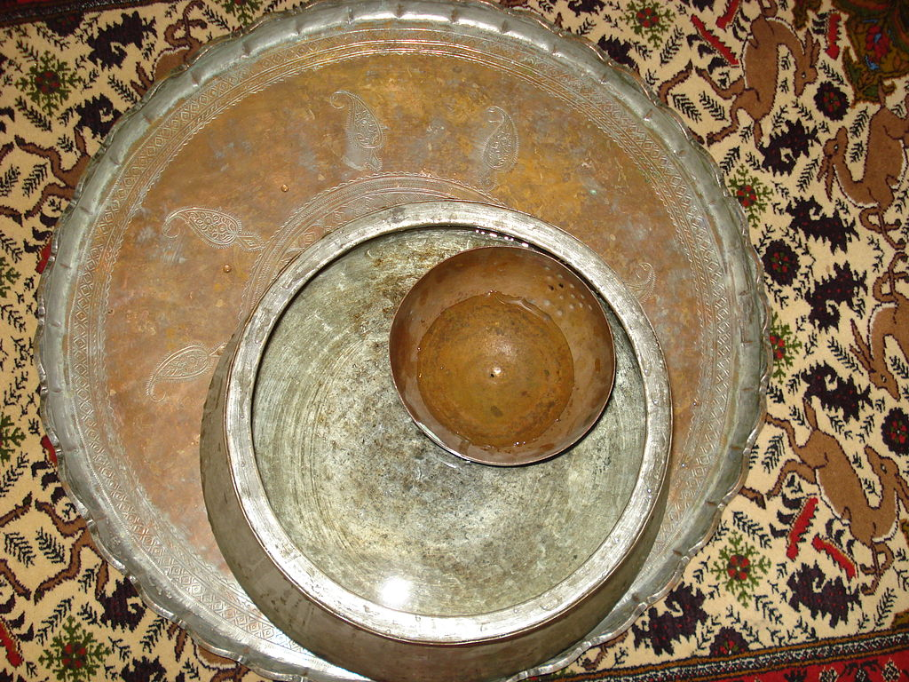
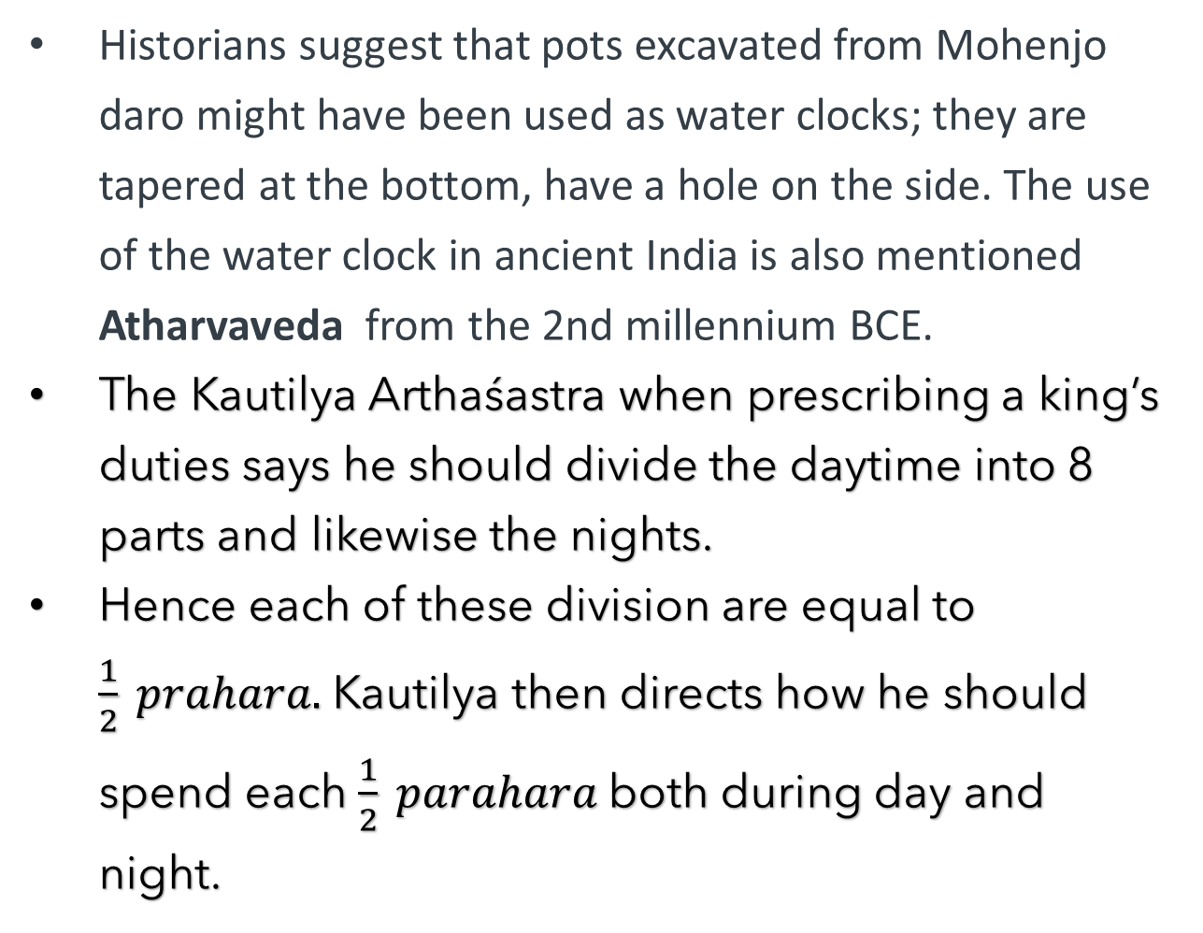
Indian Water clock(Ghatika Yantra)
Historians suggest that pots excavated from Mohenjo daro might have been used as water clocks; they are tapered at the bottom, have a hole on the side. The use of the water clock in ancient India is also mentioned Atharvaveda from the 2nd millennium BCE.
The Kautilya Arthaśastra when prescribing a king’s duties says he should divide the daytime into 8 parts and likewise the nights.
Hence each of these division are equal to $\frac{1}{2} prahara.$ Kautilya then directs how he should spend each $\frac{1}{2} parahara$both during day and night.

Slide 9
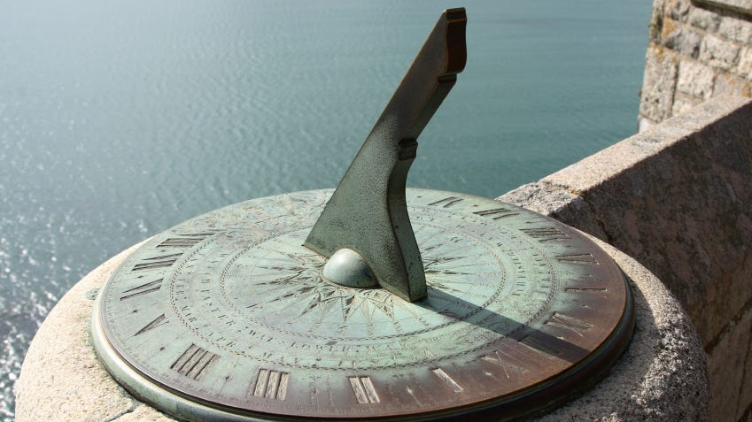
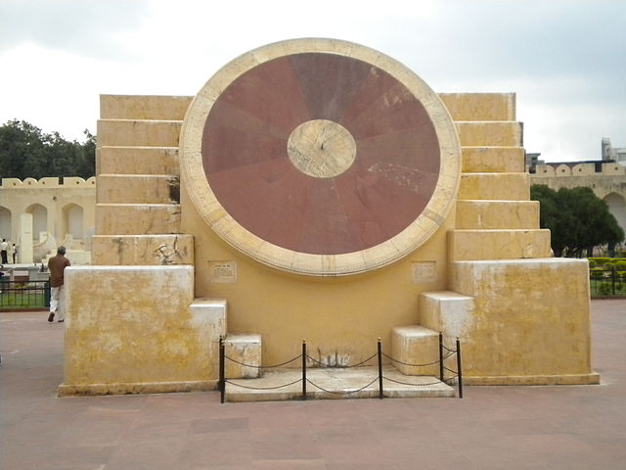
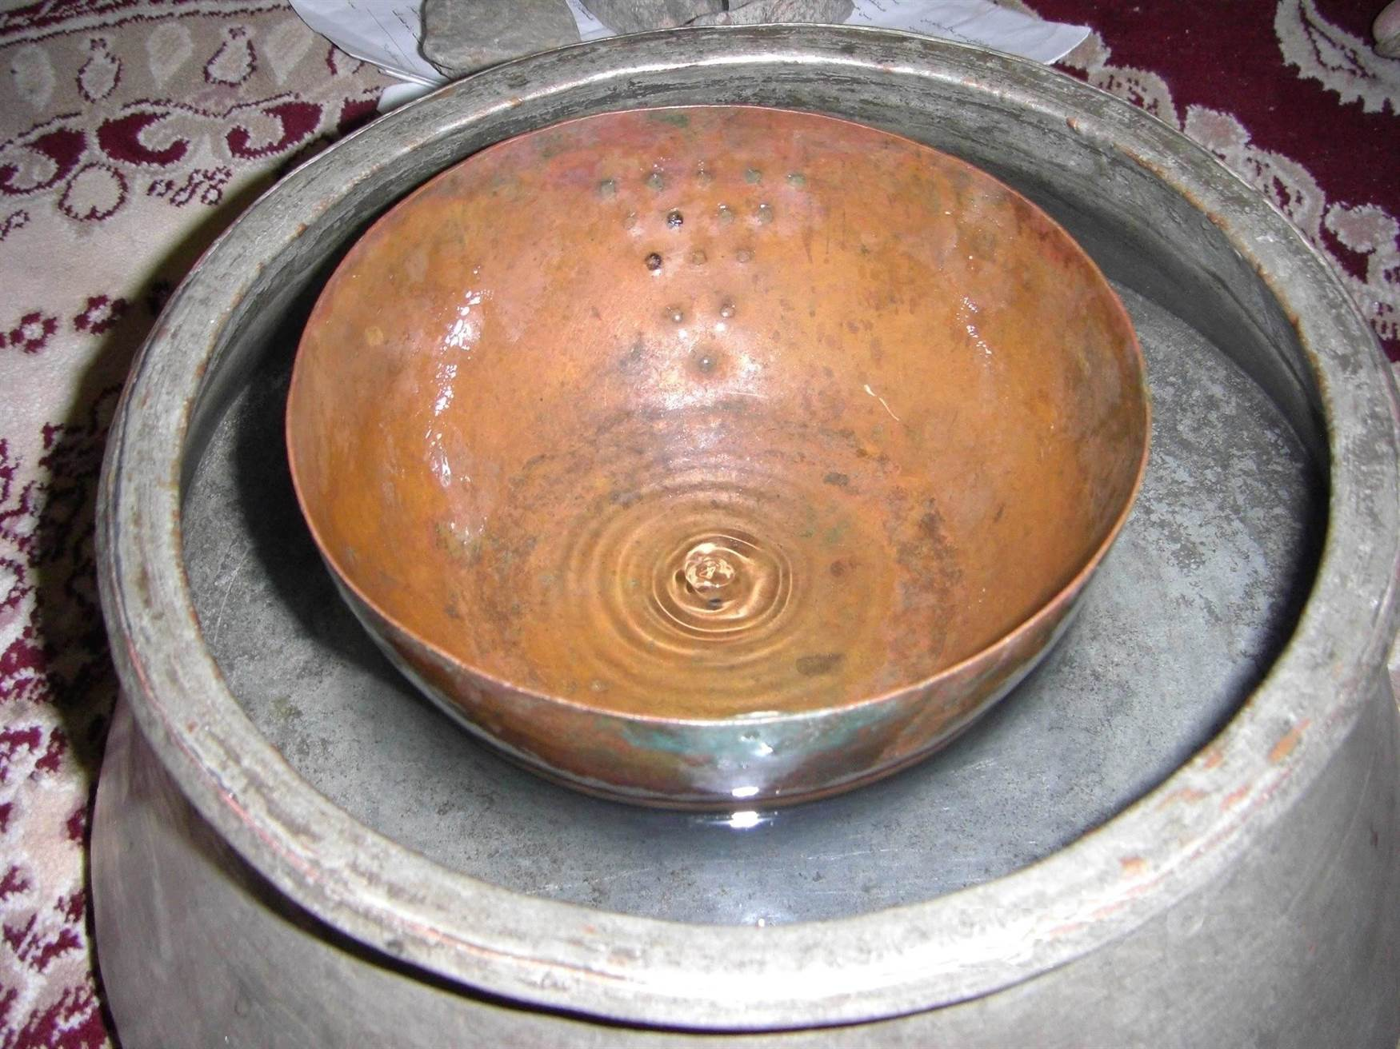
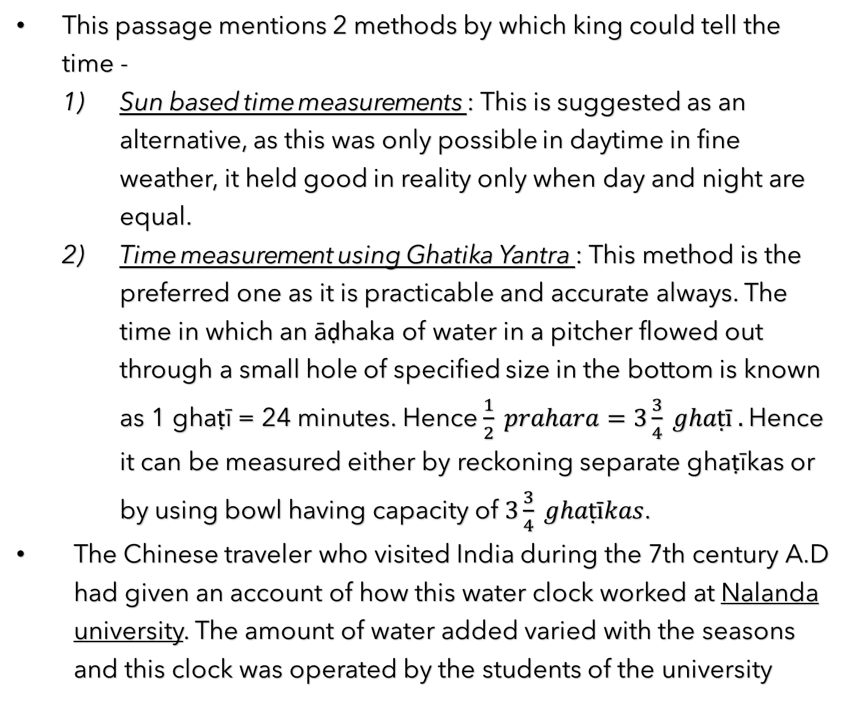
This passage mentions 2 methods by which king could tell the time -
Sun based time measurements : This is suggested as an alternative, as this was only possible in daytime in fine weather, it held good in reality only when day and night are equal.
Time measurement using Ghatika Yantra : This method is the preferred one as it is practicable and accurate always. The time in which an āḍhaka of water in a pitcher flowed out through a small hole of specified size in the bottom is known as 1 ghaṭī = 24 minutes. Hence $\frac{1}{2} prahara=3\frac{3}{4} ghaṭī .$Hence it can be measured either by reckoning separate ghaṭīkas or by using bowl having capacity of $3\frac{3}{4} ghaṭīkas$.
The Chinese traveler who visited India during the 7th century A.D had given an account of how this water clock worked at Nalanda university. The amount of water added varied with the seasons and this clock was operated by the students of the university
Samrat Yantra, Jantar Mantar

Slide 10
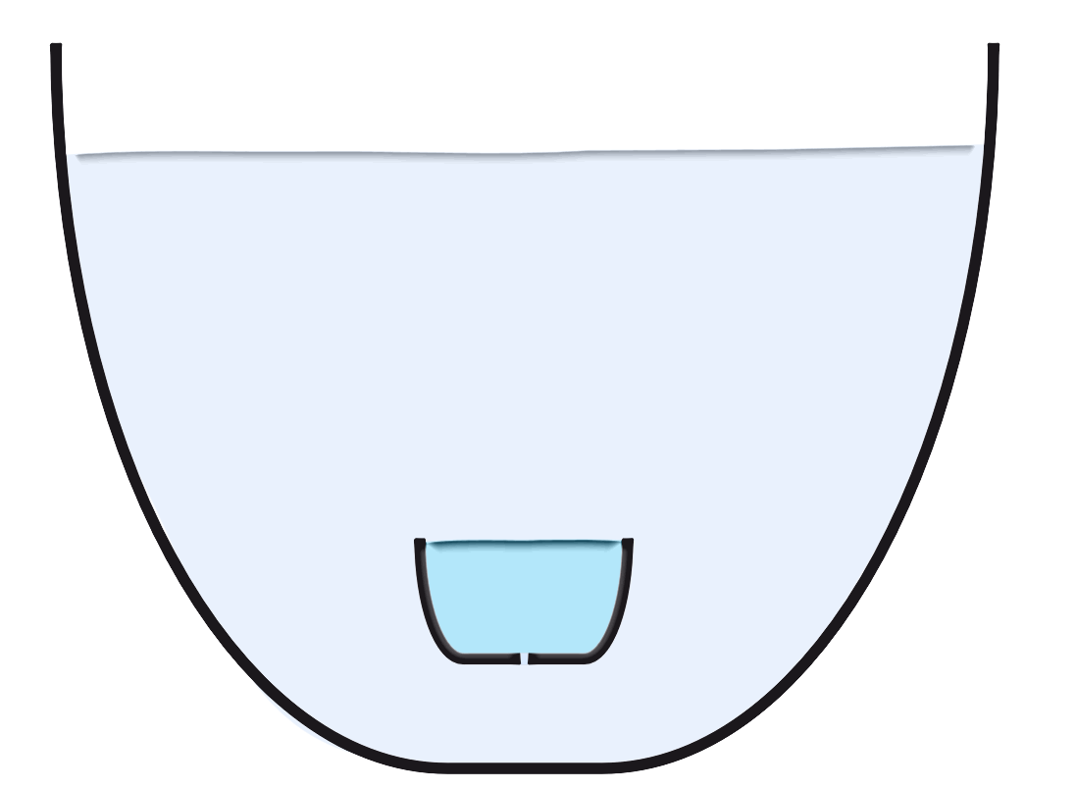
The passage of each ghati and completion of each quarter of the day (prahara) or of the night (yama) was broadcast regularly by means of drums and conch-shells. In the medieval period, the drum and the conch-shell were replaced by the gong, which was called ghadiyala in the Middle Indic.
Mughal emperor bābur, in his memory recalls the detailed description of this device. He says In every major town of Hindustan there existed a class of people known as ghariyālīs whose profession it was to keep time with this water clock and announce it by means of the gong.
Abul-Fazl’s book A'in-i Akbarī informs that time keeping and announcing was the royal prerogative under Akbar. More important, Akbar's painters depicted the water clock in two miniature paintings.
Astrologer Varahimira’s Pancasiddhantika provides more details on the water clock, building on the Suryasiddhanta. Mathematician Brahmagupta's description in Brahmasphutasiddhanta aligns with the Suryasiddhanta, and astronomer Lallacharya also offers a detailed account of the device

Slide 11
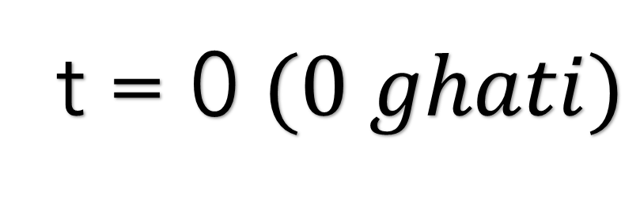
t = 0 $(0 ghati)$

Slide 12
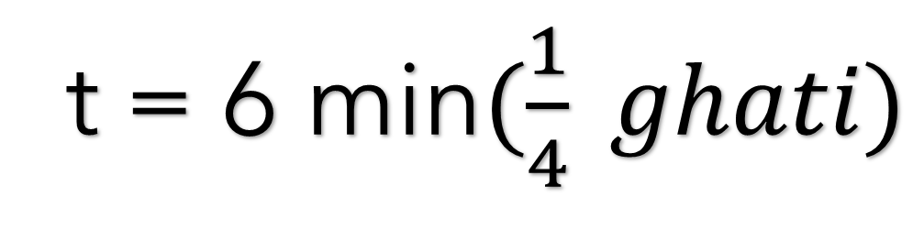
t = 6 min$(\frac{1}{4} ghati)$

Slide 13
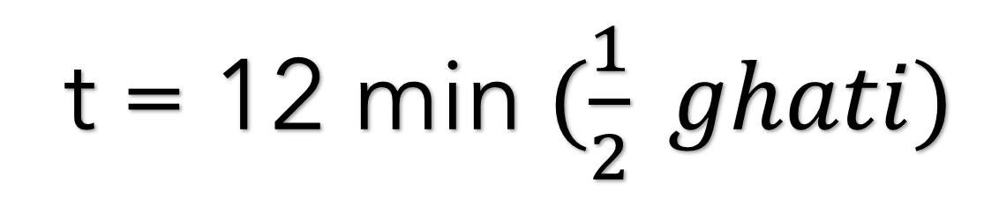
t = 12 min $(\frac{1}{2} ghati)$

Slide 14
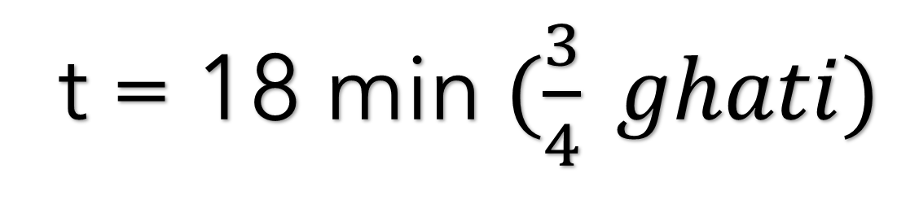
t = 18 min $(\frac{3}{4} ghati)$

Slide 15
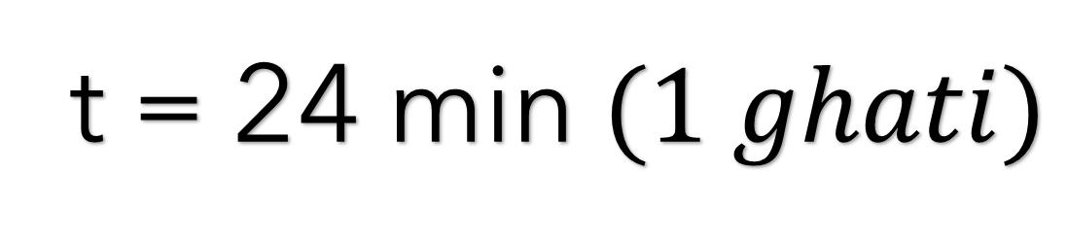
t = 24 min $(1 ghati)$

Slide 16
t = 24 min $(1 ghati)$

